Slide 1



Software Engineering cs411, FALL 2025
System Testing Planning and execution by Prof. Mohamad Kassab
Leonidas Kontothanassis kthanasi@bu.edu

Slide 2



Slide 3
AGENDA
DATA FLOW TESTING
SYSTEM TEST PLANNING
SYSTEM TEST EXECUTION

Slide 4


Slide 5
The General Idea
A program unit accepts inputs, performs computations, assigns new values to variables, and returns results.
One can visualize of “flow” of data values from one statement to another.
A data value produced in one statement is expected to be used later.
Example
Obtain a file pointer ……. use it later.
If the later use is never verified, we do not know if the earlier assignment is acceptable.
Two motivations of data flow testing
The memory location for a variable is accessed in a “desirable” way.
Verify the correctness of data values “defined” (i.e. generated) – observe that all the “uses” of the value produce the desired results.
Idea: A programmer can perform a number of tests on data values.
These tests are collectively known as data flow testing.

Slide 6
The General Idea
Data flow testing can be performed at two conceptual levels.
Static data flow testing
Dynamic data flow testing
Static data flow testing
Identify potential defects, commonly known as data flow anomaly.
Analyze source code.
Do not execute code.
Dynamic data flow testing
Involves actual program execution.
Bears similarity with control flow testing.
Identify paths to execute them.
Paths are identified based on data flow testing criteria.

Slide 7
Data Flow Anomaly
Anomaly: It is an abnormal way of doing something.
Example 1: The second definition of x overrides the first.
x = f1(y);
x = f2(z);
Three types of abnormal situations with using variable.
Type 1: Defined and then defined again
Type 2: Undefined but referenced
Type 3: Defined but not referenced

Slide 8
Data Flow Anomaly
Type 1: Defined and then defined again (Example 1 above)
Four interpretations of Example 1
The first statement is redundant.
The first statement has a fault -- the intended one might be: w = f1(y).
The second statement has a fault – the intended one might be: v = f2(z).
There is a missing statement in between the two: v = f3(x).
Note: It is for the programmer to make the desired interpretation.

Slide 9
Data Flow Anomaly
Type 2: Undefined but referenced
Example: x = x – y – w; /* w has not been defined by the programmer. */
Two interpretations
The programmer made a mistake in using w.
The programmer wants to use the compiler assigned value of w.
Type 3: Defined but not referenced
Example: Consider x = f(y, z). If x is not used subsequently, we have a Type 3 anomaly.

Slide 10
Data Flow Anomaly
The concept of a state-transition diagram is used to model a program variable to identify data flow anomaly.
Components of the state-transition diagrams
The states
U: Undefined
D: Defined but not referenced
R: Defined and referenced
A: Abnormal
The actions
d: define the variable*
r: reference (or, read) the variable
u: undefine the variable

Slide 11
Data Flow Anomaly
State transition diagram of a program variable [10] (©[1979] IEEE).

Slide 12
Data Flow Anomaly
Obvious question: What is the relationship between the Type 1, Type 2, and Type 3 anomalies and the previous Figure ?
The three types of anomalies (Type 1, Type 2, and Type 3) are found in the diagram in the form of action sequences:
Type 1: dd
Type 2: ur
Type 3: du
Detection of data flow anomaly via program instrumentation
Program instrumentation: Insert new code to monitor the states of variables.
If the state sequence contains dd, ur, or du sequence, a data flow anomaly is said to occur.
Bottom line: What to do after detecting a data flow anomaly?
Investigate the cause of the anomaly.
To fix an anomaly, write new code or modify the existing code.

Slide 13
SYSTEM TESTING PLANNING AND EXECUTION

Slide 14

Structure of a System Test Plan
The purpose of a system test plan is as follows:
It provides guidance for the executive management to support the test project
It establishes the foundation of the system testing part of the overall software project
It provides assurance of test coverage by creating a requirement traceability matrix
It outlines an orderly schedule of events and test milestones that are tracked
It specifies the personnel, financial, equipment, and facility resources required to support the system testing part of a software project

Slide 15
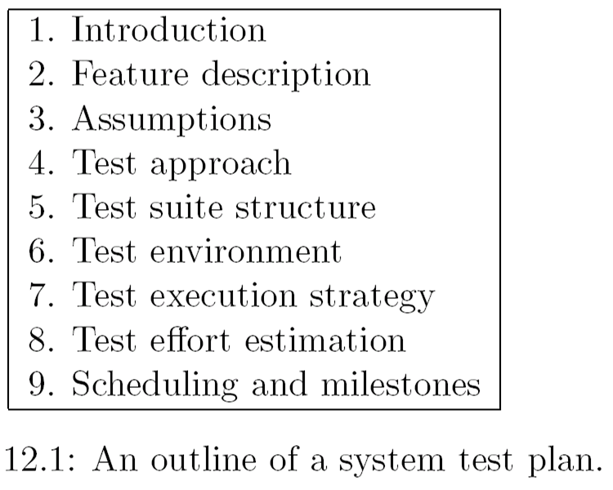
Structure of a System Test Plan

Slide 16
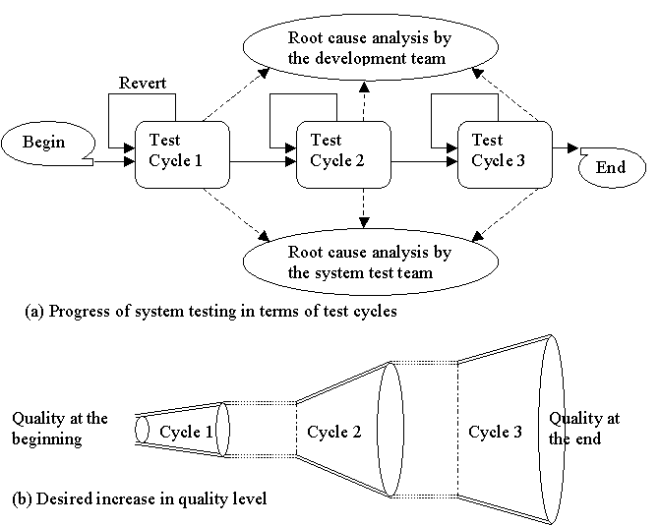
A Multi-Cycle System Test Strategy

Slide 17
Characterization of Test Cycles
Each test cycle is characterized by a set of six parameters:
Goals
Assumptions
Test execution
Revert and Extension criteria
Actions
Exit criteria

Slide 18
Characterization of Test Cycles
Goals
System test team sets its own goals to be achieved in each test cycle
These goals are ideal in the sense these are very high standard
Goals are specified in terms of the number of test cases to pass in a cycle
Assumptions
How often the builds will be selected during in a system test cycle?
For example “the team can accept builds from SIT group on a daily basis during a test cycle”
Test Execution
Prioritization of test execution changes between test cycles
Test cases that exercise basic functionalities have higher priority than the rest in the first test cycle
Test cases that have failed in one test cycle have a higher priority in the following test cycle
Test cases in certain groups have higher priority than others
Notes:
SIT = Systems Integration Testing

Slide 19
Characterization of Test Cycles
Revert and Extension criteria
It may not be useful to continue a test cycle if it is found that a software is of poor quality
Often a test cycle is extended due to various reasons
A need to re-execute all the test cases in a particular test group because a large fraction of the test cases within the group failed
A significantly large number of new test cases were added while test execution was in progress
The conditions for prematurely terminating a test cycle and for extending a test cycle must be precisely stated

Slide 20
Characterization of Test Cycles
Actions
Too many test cases may fail during a test cycle
The development team is alerted
The developers take action in the form of root cause analysis (RCA)
Corrective actions are taken by updating the design specification, reviewing the code, and adding new test cases to the unit and integration test plan
The system test team has to design a large number of new test cases during a test cycle
The system test team initiates a root cause analysis (RCA)
The team studies the new test cases and categories them into different groups based on the functional requirements
The relevant requirements are studied to understand why the test team was unable to identify the objectives of these new test cases in the first place

Slide 21
Characterization of Test Cycles
Exit Criteria
An exit criterion specifies the termination of a test cycle
One may exit a test cycle even if goals for that particular test cycle are not fully achieved
The exit criteria are defined based on few quality metrics associated with the test cycle
These quality metrics must be monitored during the test cycle
Example of exit criteria
95% of test cases passed and all the known defects are in CLOSED state

Slide 22
Example of a Testing Cycle
Test Cycle 1
Goals: To maximize the number of passed test cases (98%)
Assumptions: Test groups accepts a s/w image one every week for the first four weeks and one every 2 weeks afterwards
Test Execution: Test cases are executed according the prioritization discussed earlier
Revert and Extension criteria:
If the number of failed test cases reaches 20% of the total number of test cases to be executed the system test team abandons this test cycle
If more than two unique crashes are observed during the test cycle, the system test team runs regression tests after the crash defects are fixed.
If the number of failed test cases for any group of test cases reaches 20% of the number of test cases in the group during the test cycle, the test team re-execute all the test cases in that group in the test cycle after the defects are fixed

Slide 23
Example of a Testing Cycle
Test Cycle 1(Cont’d)
Actions:
The software development group initiates a root cause analysis (RCA) during the test cycle if the total number of failed test cases reaches some pre-set values as shown in Table 12.4
(b) The system test group initiates an RCA if the number of new test cases increases by 10% of the total number of test cases designed before the test cycle was started
Exit Criteria: The test cycle is considered to have completed when the following predicates hold: (i) new test cases are designed and documented for those defects that were not detected by the existing test case - those are referred to as test case escapes, (ii) all test cases are executed at least once, (iii) 95% of test cases passed, and (iv) all the known defects are in CLOSED state

Slide 24
Test Effort Estimation
Two major components:
The number of test cases created by one person in one day
The number of test case executed by one person in one day

Slide 25
Test Effort Estimation
Estimation of Number of test cases
Estimation of Number of Test Cases Based on Test Group Category
It is straightforward to estimate the number of test cases after the test suite structure and the test objectives are created
simply count the number of test objectives
Estimation of Number of Test Cases Based on Function Points
Total number of test cases = (Function Points)^{1.2}

Slide 26
Function Points
The central idea in the function point method is as follows:
Given a functional view of a system, in the form of the number of user inputs, the number of user outputs, the number of user on-line queries, the number of logical files, and the number of external interfaces, one can estimate the project size in number of lines of code required to implement the system and the number of test cases required to test the system
The function point of a system is a weighted sum of the numbers of
inputs,
outputs,
inquiries produced to, or generated by, the software
master files
external files

Slide 27
Function Points
Inputs: User inputs that modify the system (i.e. forms)
Outputs: Processed data sent to users (i.e. report)
Inquiries: Requests that don’t change data
Master files: Data maintained by the system
External files: Data used but not maintained by the system
Assign each Input, Output, Inquiry, Master File and External File a level of complexity (low, medium, high). This is somewhat subjective but there are rules, the more data types you deal with the more complex they get. Also, if it looks complex to you, then it will likely be complex for you to do ☺

Slide 28
Function Points
Function Type | Low | Average | High
Input (EI) | 3 | 4 | 6
Output (EO) | 4 | 5 | 7
Inquiry (EQ) | 3 | 4 | 6
Master File (MF) | 7 | 10 | 15
External File (EF) | 5 | 7 | 10

Slide 29
Function Points
Calculate your total function points across all 5 categories, then add them up and there are published tables for #lines of code needed to implement a system with a specific function point complexity. A very productive engineer produces ~20K LOC/year (pre-AI number).
Language | Average LOC / FP
Assembly | ~300
C | ~120
C++ | ~50
Java | ~50
Python | ~20
SQL | ~15

Slide 30
Function Points
You can also use Function points to estimate the number of tests cases you may need.
Test Type | Approx. Test Cases per FP
Unit tests | 1 – 2 per FP
Integration tests | 0.5 – 1 per FP
System/Functional tests | 1 – 3 per FP
Regression tests | 0.5 – 1 per FP

Slide 31
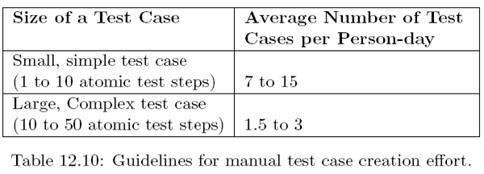
Test Effort Estimation
Test Case Creation Effort
The productivity of the manual test case creation is summarized in the following tables:

Slide 32
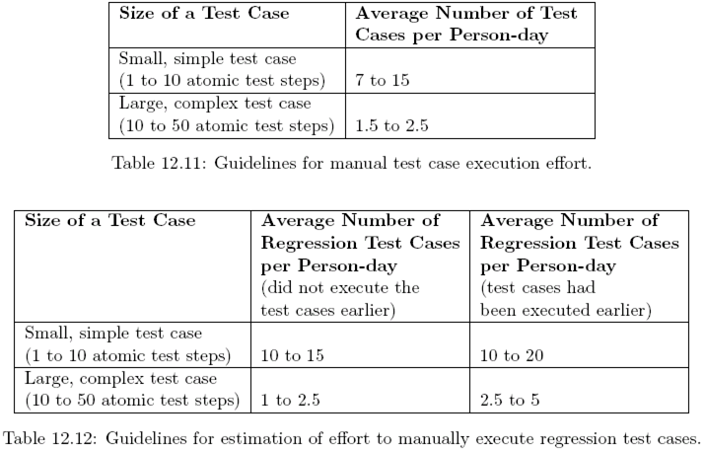
Test Case Execution Effort

Slide 33
Scheduling and Test Milestones
It is essential to understand and consider the following steps in order to schedule a test project effectively:
Develop a detailed list of tasks
List up all the major milestones needed to be achieved during the test project
Identify the interdependencies among the test tasks and any software milestones that may influence the flow of work
Identify the different kinds of resources and expertise needed to fulfill each task on the list
Estimate the quantity of resources needed for each task
Identify the types and quantities of resources available for this testing project
Assume that the rest of the resources will be available by certain dates
Allocate the resources to each task

Slide 34
System Test Automation
Benefits of system test automation
Test engineer productivity
Coverage of regression testing
Re-usability of test cases
Consistency in testing
Test interval reduction
Reduces software maintenance cost
Increased test effectiveness
Pre-requisites for test automation
The system is stable and its functionalities are well defined
The test cases to be automated are unambiguous
The test tools and infrastructure are in place
The test engineers have prior successful experience with automation
Adequate budget should have been allocated for the procurement of tools

Slide 35
Modeling Defects
A life-cycle model in the form of a state-transition diagram as shown in the Figure in the next slide.
The different states are briefly explained in slide 33.
Two key concepts involved in modeling defects are the levels of priority and severity
A priority level is a measure of how soon the defect needs to be fixed, i.e., urgency.
Critical (1), High (2), Medium (3), and Low(4)
A severity level is a measure of the extent of the detrimental effect of the defect on the operation of the product
Critical (1), High (2), Medium (3), and Low (4)
The defect schema is given in Table in slide 37.

Slide 36
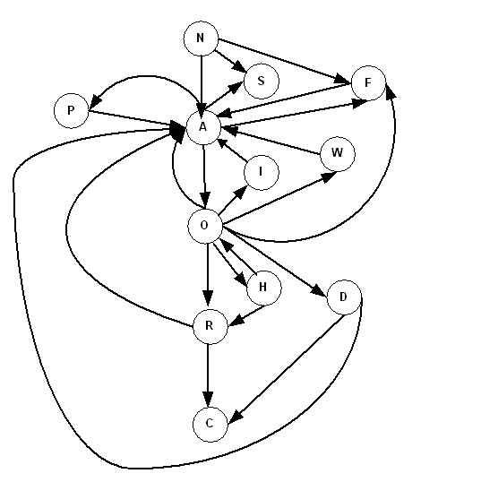
Modeling Defects
State-transition diagram representation of the life-cycle of a defect

Slide 37
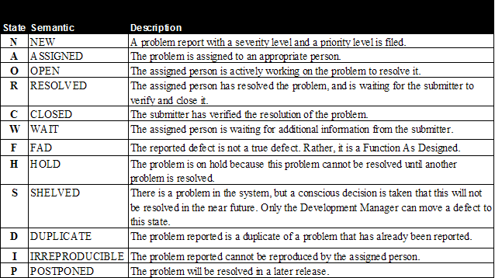
Modeling Defects

Slide 38
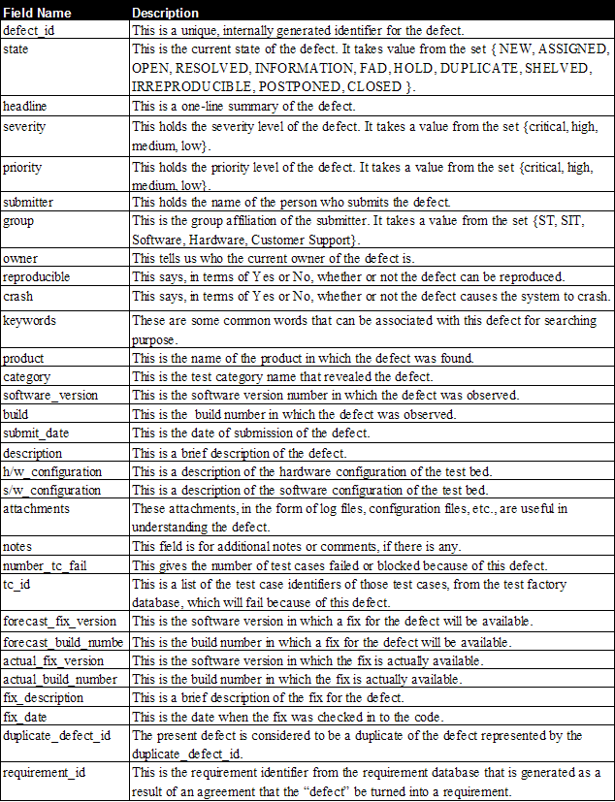
Modeling Defects
Defect schema summary fields

Slide 39
Metrics for Tracking System Test
We categorized execution metrics into two classes:
Metrics for monitoring test execution
Metrics for monitoring defects

Slide 40
Metrics for Monitoring Test Execution
Test case Escapes (TCE)
A significant increase in the number of test case escapes implies that deficiencies in the test design
Planned versus Actual Execution (PAE) Rate
Compare the actual number of of test cases executed every week with the planned number of test cases
Execution Status of Test (EST) Cases
Periodically monitor the number of test cases lying in different states
Failed, Passed, Blocked, Invalid and Untested
Useful to further subdivide those numbers by test categories
Notes:
TCE = How many defects were found at a later stage (post testing).

Slide 41
Metrics for Monitoring Defect Reports
Function as Designed (FAD) Count
Irreproducible Defects (IRD) Count
Defects Arrival Rate (DAR) Count
Defects Rejected Rate (DRR) Count
Defects Closed Rate (DCR) Count
Outstanding Defects (OD) Count
Crash Defects (CD) Count
Arrival and Resolution of Defects (ARD) Count

Slide 42
Orthogonal Defect Classification
Age: The history of the design or code that had the problem. The age specifies whether the defect was found in new, old (base), rewritten, or refixed code.
New: The defect is in a new function which was created by and for the current project.
Base: The defect is in a part of the product which has not been modified by the current project. The defect was not injected by the current project
Rewritten: The defect was introduced as a direct result of redesigning and/or rewriting of old function in an attempt to improve its design or quality.
Refixed: The defect was introduced by the solution provided to fix a previous defect.

Slide 43
Defect Causal Analysis
In DCA, defects are analyzed to
Determine the cause of an error
Take actions to prevent similar errors from occurring in the future
Means to remove similar defects that may exist in the system or to detect them at the earliest possible point in the software development process
It is sometimes referred to as defect prevention or root-cause defect analysis (RCA)
Three key principles to drive defect causal analysis:
Reduce the number of defects to improve quality
Apply local expertise where defects occur
Focus on systematic errors
DCA focuses on understanding of cause-effect relationship
There must be a correlation between the hypothesized cause and the effect
The hypothesized cause must precede the effect in time
The mechanism linking the cause to the effect must be identified

Slide 44
Defect Causal Analysis
Linking the causes to the effect consists of five steps:
When was the failure detected and the corresponding fault injected?
What scheme is used to classify errors?
What is the common problem (systematic error)?
What is the principal cause of the errors?
Cause-effect diagram may be used to identify the cause
How could the error be prevented in the future?
Preventive: A preventive action reduces the chances of similar problems occurring in the future
Corrective: A corrective action means fixing the problems. Attacking the cause itself may not be cost effective in all situations
Mitigating: A mitigating action tries to counter the adverse consequences of problems
Some Preventive and Corrective actions:
Training, Improvement in Communication, Using tools, Process Improvement

Slide 45


Readings , Assignments, Project Tasks
Read:
System Testing Execution (Supplemental Materials).
Assignments & Project Tasks:
Assignment 3 is open (Due on Friday) (Individual Submission)

